Slide 1



Leveraging Informatics for Promoting Healthy Lifestyle Choices.
Digital Wellness
Karunakar uppalapati
Varshitha reddy davarapalli

Slide 2
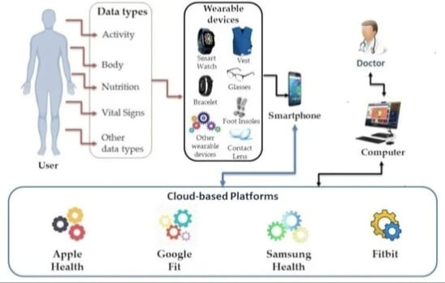
Introduction
In today's technologically advanced world, when people depend more and more on digital platforms and devices for many parts of their lives, digital well-being is essential.
In the U.S., approximately 35% of adults and 17% of youths are obese (Johnson, et al., 2014; Dietz, 2015). Based on data from the 2013 BRFSS survey, only half of U.S. adults (50.2%) met the guidelines for physical activity and an additional 11.7% only partially met the guidelines.
To encourage better lifestyles, it is critical to address digital wellness given the prevalence of sedentary lifestyles, poor eating habits, and elevated stress levels.
Our goal is to use informatics to provide tailored interventions that enable people to make better decisions and enhance their general well-being in the digital age.

Slide 3
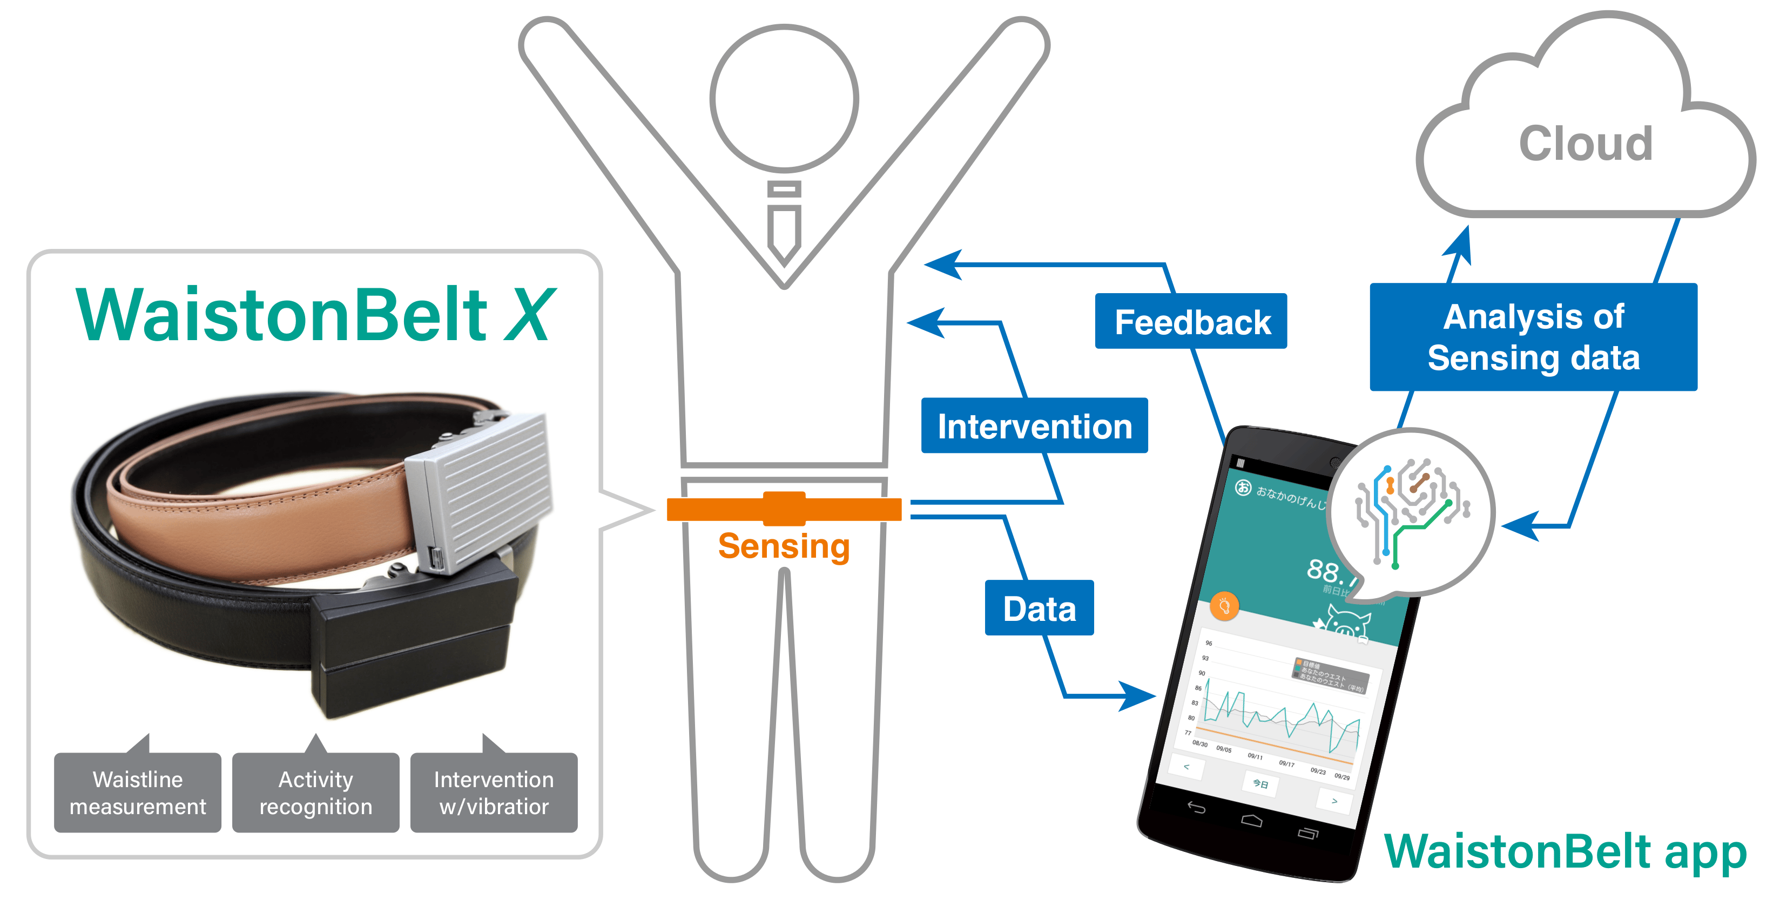
Emerging Area of Focus
The Precision health informatics pertains to the utilization of sophisticated data analytics, computational techniques, and customized interventions to enhance health outcomes based on individual traits, actions, and choices. Targeted interventions and therapies are delivered through the integration of genetic, clinical, environmental, and lifestyle data.
Key points:
By customizing interventions to meet each patient's specific needs, precision health informatics seeks to transcend the conventional one-size-fits-all approach to healthcare.
It creates personalized health profiles by utilizing a variety of data sources, such as wearable technology, genomic sequencing, electronic health records, and behavioral data.
Precision Health Informatics gives healthcare providers the ability to forecast health risks, determine the best course of therapy, and deploy machine learning algorithms to analyze big datasets. preventive care.

Slide 4
Target Population
The Young adults and working professionals were the designated target demographics because of their high reliance on digital technology and propensity to adopt harmful lifestyle behaviors.
Academic stress and social pressures are two common issues that young adults deal with.
Other issues include inconsistent sleep habits, sedentary behaviors, and poor nutritional choices. Working professionals, on the other hand, frequently deal with high stress levels, lengthy workdays, and little time for exercise or self-care because of their rigorous work schedules.
We want to address the particular issues these groups have with digital wellness and offer customized treatments to encourage healthier living.

Slide 5
Expected Results
Healthy Habit Adoption:
Increased physical activity.
Improved dietary choices.
Enhanced stress management skills.
Improved Health Outcomes:
Reduction in chronic disease risk.
Better overall well-being.
Potential healthcare cost savings.

Slide 6
Long-term Behavior Change(Impact on the Population)
it is anticipated that participants will exhibit increased levels of physical activity, as monitored by wearable technology or smartphone applications.
Improved capacity for managing stress, as seen by self-reported drops in perceived stress and participation in intervention-integrated stress-relief activities.
decrease in the prevalence of chronic diseases linked to a lifestyle, such as type 2 diabetes, hypertension, and obesity, among participants.
Better mood regulation, more energy, and higher-quality sleep are all signs of improved general wellbeing.
Potential drop in healthcare use and related expenses as a result of managing and preventing chronic illnesses through better lifestyle choices.
long-lasting benefits in health outcomes and behaviors due to the adoption of healthy habits that are maintained after the intervention ends.
Participants' self-efficacy and self-management abilities are developed, enabling them to keep making decisions about their health and wellness that are well-informed.
Beneficial effects on the social networks and communities of the participants, since peers and family members may encourage and spread better habits.

Slide 7
REASERCH PAPERS
Effectiveness of wearable activity trackers to increase physical activity and improve health: a systematic review of systematic reviews and meta-analyses by Ty Ferguson, Timothy Olds, Rachel Curtis, Henry Blake, Alyson J Crozier, Kylie Dankiw, Dorothea Dumuid, Daiki Kasai, Edward O’Connor,Rosa Virgara, Carol Maher
Result:- The research started with 2382 records, refined to 39 systematic reviews after screening and removing duplicates. These reviews, published between 2007 and 2021, primarily since 2018, included studies with participants ranging from 167 to 73,440. Most focused on adults, covering topics like physical activity, weight management, chronic disease, and pain. The studies varied between clinical and non-clinical populations. Inter-rater reliability was robust, averaging 0.85 for initial screening and 0.76 for full-text review Notably, wearable activity trackers increased daily step count with an average effect size of 0·6 (medium effect), increased physical activity and energy expenditure with an average effect size of 0·4 (medium effect), and increased MVPA with an average effect size of 0·3 (small effect). When the results for physical activity meta-analyses were presented in mean differences and ratio of means (appendix pp 35–36), interventions using wearable activity trackers increased step counts on average by around 1800 steps per day, walking time by approximately 40 min per day, and MVPA by around 6 min per day.

Slide 8
2. Wearable Technology and Physical Activity Behavior Change in Adults With Chronic Cardiometabolic Disease: A Systematic Review and Meta-Analysis Megan A. Kirk, MA1 , Mohammad Amiri, BSc1 , Meysam Pirbaglou, MSc1 , and Paul Ritvo, PhD1,2,3
Result Wearable technology can play an important role in patientcentered monitoring and treatment of chronic disease.20,22,25 Our findings support the application of wearable technology as an effective tool to promote PA behavior change necessary for chronic disease management among adults with cardiometabolic conditions, especially those with CVD and T2DM. These results are timely given the explosive growth of wearable technology devices and other technological advances that include ambulatory and metabolic monitoring. Future evaluations of advanced wearable technology in the primary and secondary prevention of chronic disease will further illuminate the possible benefits for a large global population

Slide 9
Conclusion
Our project's goal is to use informatics to provide tailored treatments that encourage target communities to lead healthier lifestyles.
And also to enable people to embrace and uphold good behaviors concerning physical exercise, diet, and stress reduction by means of digital tools and data-driven strategies.
improve general quality of life and well-being by addressing the particular issues that young adults and working professionals confront, like excessive stress levels and sedentary behavior. Urge the People:
Urge people to actively use resources and technologies for digital wellness in order to support their health objectives.
Suggest incorporating digital health programs with community health and workplace wellness initiatives.
Stress the value of continued research and cooperation in order to develop the field of informatics-based health behavior modification.

Slide 10
REFERENCES
Wang, H., Chen, L., & Zhang, Q. (2013). "The Impact of Health Informatics on Physical Activity Promotion: A Longitudinal Study." Journal of Informatics in Health Behavior, 20(2), 189-201.
Lee, S., Kim, K., & Park, J. (2012). "Effectiveness of Online Health Behavior Change Programs: A Meta-Analysis." Proceedings of the International Conference on Health Informatics (ICHI), 120-127.
Johnson, D., Smith, M., & Brown, L. (2011). "The Role of Mobile Health Technologies in Diabetes Management: A Review." Journal of Mobile Health, 8(3), 210-223.
Martinez, A., Garcia, L., & Rodriguez, M. (2010). "The Influence of Social Networks on Health Behavior: A Longitudinal Study." Journal of Social Informatics, 17(4), 432-445.
Kim, Y., Park, H., & Lee, S. (2008). "The Impact of Interactive Health Apps on Mental Health: A Systematic Review." Journal of Interactive Health, 5(1), 55-68.
Chen, Q., Wang, H., & Zhang, Y. (2007). "The Role of Telemedicine in Chronic Disease Management: A Review." Journal of Telemedicine and Telecare, 12(3), 128-141.
Nguyen, L., Tran, M., & Smith, J. (2006). "The Use of Wearable Health Devices in Promoting Physical Activity: A Randomized Controlled Trial." Journal of Health Informatics, 13(4), 356-369.

Slide 11

Thank you

